Slide 1
Bootstrap Lec-1
Heba Mostafa

Slide 2
AGENDA
Bootstrap Overview
Bootstrap History
Why Bootstrap?
Key points in Bootstrap 5
Getting Started
Typography
Class Utilizes
Breakpoints
Containers
Grid System
Images
ToolTip

Slide 3
Bootstrap overview
Bootstrap is a popular open-source front-end framework that is used to create responsive and mobile-first websites and web applications.
Mark Otto and Jacob Thornton developed the Bootstrap, at Twitter. In August 2011, Bootstrap was released as an open-source product, on GitHub.

Slide 4
bootstrap History
Jan 2012
Aug 2013
Oct 2014
May 2021
Bootstrap 2
Bootstrap 3
Bootstrap 4
Bootstrap 5

Slide 5
Why to Learn Bootstrap?
Responsive design: Bootstrap is built with a mobile-first approach, meaning it is designed to be responsive and adapt to different screen sizes. This ensures that your mobile application looks good and functions well on various devices, including smartphones and tablets.
Time-saving: Bootstrap provides a wide range of predefined and customizable CSS and JavaScript components, such as grids, buttons, navigation bars, and modals. These ready-to-use components help developers save time and effort by eliminating the need to code everything from scratch.
Consistent appearance: With Bootstrap, you can achieve a consistent and professional-looking design across your mobile application. It offers a set of predefined styles and themes that can be easily customized to match your brand's identity.

Slide 6
Why to Learn Bootstrap?
Cross-browser compatibility: Bootstrap is designed to work well across different web browsers, ensuring that your mobile application functions consistently for users, regardless of the browser they prefer to use.
Community and support: Bootstrap has a large and active community of developers who contribute to its improvement and provide support through forums and online resources. This can be helpful if you encounter any challenges or have questions during the development of your mobile application.
Continuous updates and enhancements: Bootstrap is regularly updated and improved with new features, bug fixes, and performance enhancements. By using Bootstrap, you can take advantage of these updates to keep your mobile application up-to-date and optimized.

Slide 7
Key points in Bootstrap 5
Smaller file size: Bootstrap 5 designed to be more lightweight, with the removal of jQuery and other dependencies. It has switched to Vanilla JavaScript. This leads to faster load times.
Improved grid system: The grid system comes with a new, more flexible layout. It introduces a new gap utility and no longer relies on floats.
Updated default colors and theming: Introduces a new default color palette and theme. The new colors are more modern and visually appealing.
Improved form controls: The form controls have been enhanced with new styles and options. There are new styles for checkboxes and radio buttons, as well as improved custom select menus.
New helpers and utilities: Introduces new utility classes and helpers, such as vertical centering, stretched link utility, and more.
Improved documentation : The documentation for Bootstrap 5 has been updated and improved, making it easier to use and understand.

Slide 8
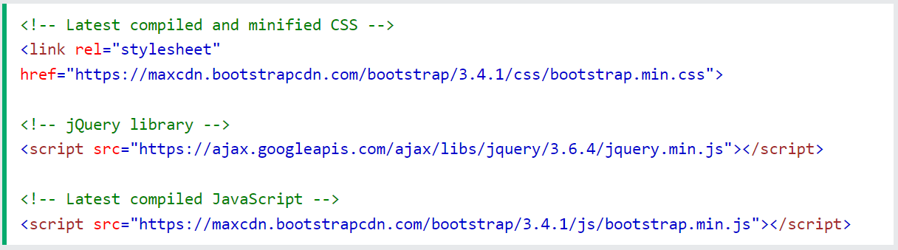
Getting started with Bootstrap
Include Bootstrap through CDN links:
Alternative CDNs:
https://cdnjs.com/libraries/bootstrap
Notes:
CDN, Content Delivery Network, is a network of servers that speeds up the loading of webpages for data-heavy applications.

Slide 9
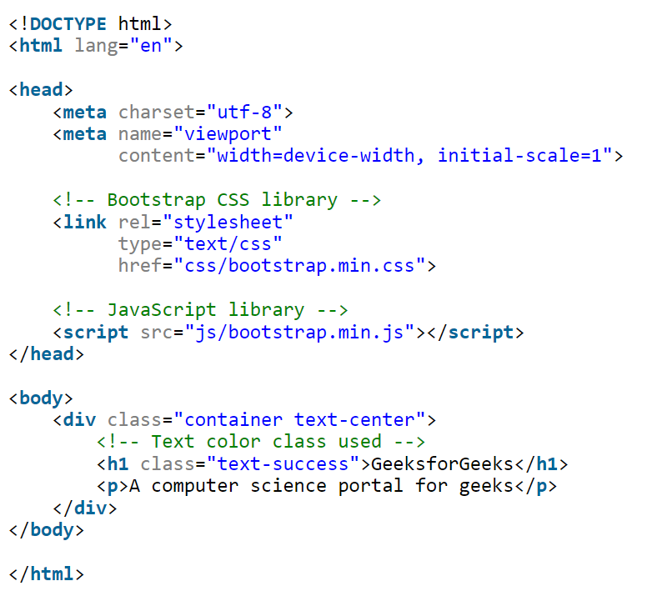
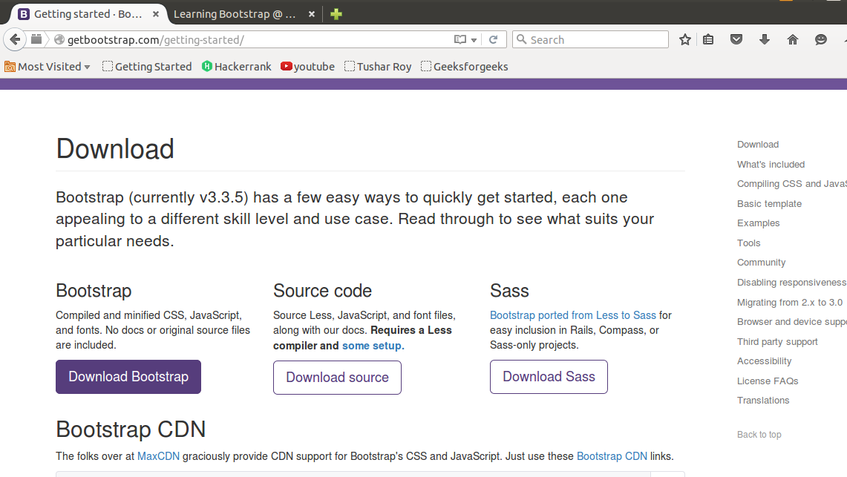
Getting started with Bootstrap
2. Goto www.getbootstrap.com and click Getting Started. Click on the Download Bootstrap button.
A.zip file would get downloaded. Extract the zip file and go to the distribution folder. It contains two folders named CSS and JS.
Add the file link to the HTML document and then open the web page using web browsers.

Slide 10
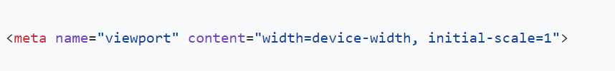
Important globals
HTML5 doctype: Bootstrap requires the use of the HTML5 doctype. Without it, you’ll see some funky and incomplete styling.
Viewport meta: Bootstrap is developed mobile first, a strategy in which we optimize code for mobile devices first and then scale up components as necessary using CSS media queries. To ensure proper rendering and touch zooming for all devices, add the responsive viewport meta tag to your <head>

Slide 11
Typography
Headings: <h1>,<h2>,…
Display headings: When the headings are to be displayed in a larger and opinionated style
Lead & alignment : The lead class makes the paragraph stand out. It gives a larger font size, lighter weight, and a taller line height to the text in a paragraph.
Text decoration: underline, line-through
Text color
Background color
Notes:
https://getbootstrap.com/docs/5.3/helpers/color-background/

Slide 12
Utility Classes
margin & padding
Borders
Box shadow
Font weight
Notes:
https://getbootstrap.com/docs/5.3/utilities/borders/

Slide 13
Containers
Containers are used to contain, pad, and center the content within them.
There are three different container classes in Bootstrap:
container (sets responsive max-widths).
container-{breakpoint} (width: 100% until specified breakpoint).
container-fluid (width: 100% at all breakpoints).

Slide 14
Containers
.container: The .container class provides a responsive fixed width container.
The div with class “container” will have a fixed left and right margin and will not take the complete width of its parent or the viewport.

Slide 15
Containers
.container-fluid: The .container-fluid class provides a full-width container which spans the entire width of the viewport.
The div with class “container-fluid” will take up the complete width of the viewport and will expand or shrink whenever the viewport is resized.

Slide 16
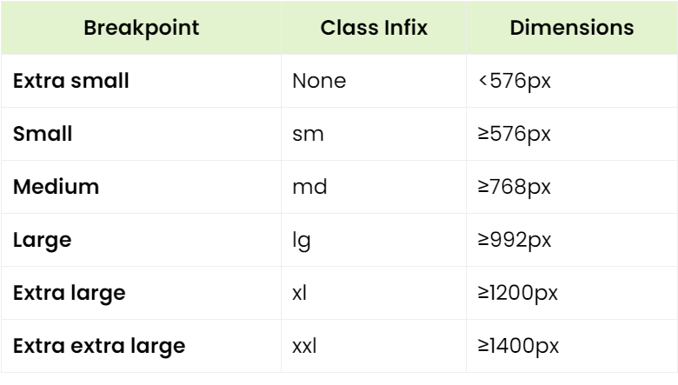
Breakpoints
Breakpoints in Bootstrap are used to create responsive designs. You may adjust them at a particular viewport or device size.
CSS media queries allow us to customize styling based on browsers and operating system parameters. Media queries in Boostrap mostly use min-width to control the breakpoints.

Slide 17
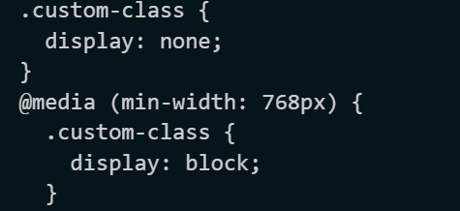
Breakpoints
Media queries
Bootstrap is developed to be mobile first, hence media queries are used to create wise breakpoints for its layouts and interfaces.
Min-width
Setting min-width in the breakpoints means CSS is only applied to devices whose width is greater than min-width of the device.

Slide 18
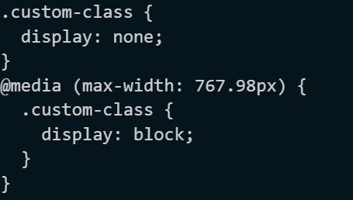
Breakpoints
2. Max-width
Setting min-width in the breakpoints means CSS is only applied to devices whose width is smaller than mentioned in the media query.

Slide 19


Breakpoints
3. Single Breakpoint
Single breakpoint means targeting a specific screen sizes using minimum and maximum breakpoint widths in media queries.
4. Between Breakpoints
Between breakpoints target multiple breakpoints.
For example: @media (min-width: 892px) and (max-width: 1278px)

Slide 20
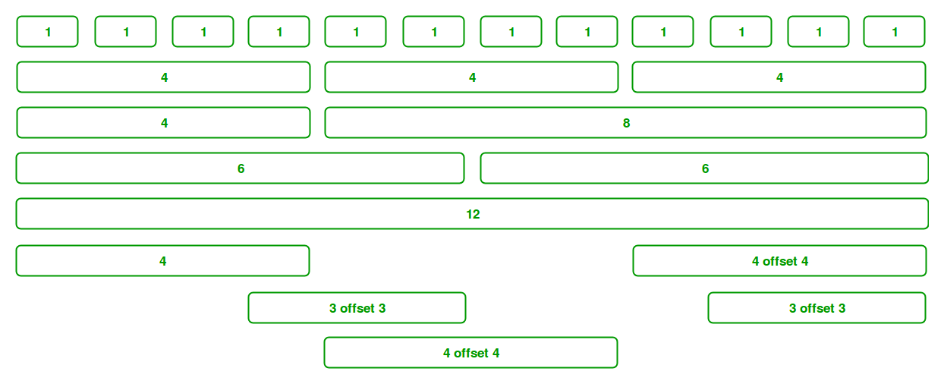
Grid system
Bootstrap Grid System allows up to 12 columns across the page.
Notes:
The basic difference between CSS grid layout and CSS flexbox layout is that flexbox was designed for layout in one dimension - either a row or a column. Grid was designed for two-dimensional layout - rows, and columns at the same time.

Slide 21
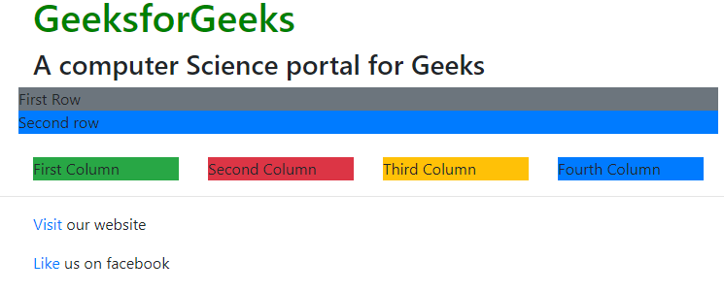
Grid components
Rows: Rows must be placed inside a ‘container’ or ‘container-fluid’ for proper alignment and padding. We use rows to create horizontal groups of columns.
Columns: Grid columns are created by specifying the number of twelve available columns you wish to span. For example, three equal columns would use three “col-sm-4”.

Slide 22
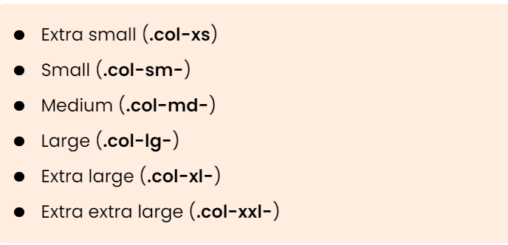
Grid classes
There are six classes in Bootstrap Grid System:

Slide 23
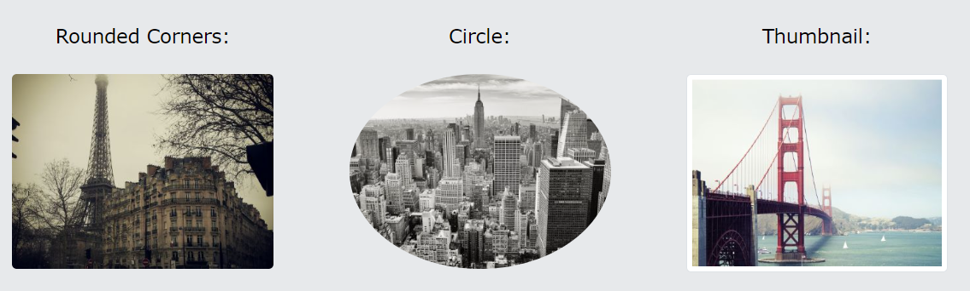
Images
Image shapes

Slide 24
tooltip
As tooltips depend on Popper, a third party library, for positioning, you must include popper.min.js before bootstrap.js or use bootstrap.bundle.min.js / bootstrap.bundle.js, which contains Popper for tooltips to work.
You must initialize the tooltips first, as tooltips are opt-in for performance reasons.
A tooltip will never be shown for a zero-length title value.
Triggering tooltips will not work on hidden elements.

Slide 25
Enable Tooltips
Creating a Tooltip
The data-bs-toggle attribute defines the tooltip.
The title attribute defines the text to be displayed inside the tooltip.

Slide 26
THANK YOU
Heba Mostafa
Heba.abdelmagead97@gmail.com

